Slide 1
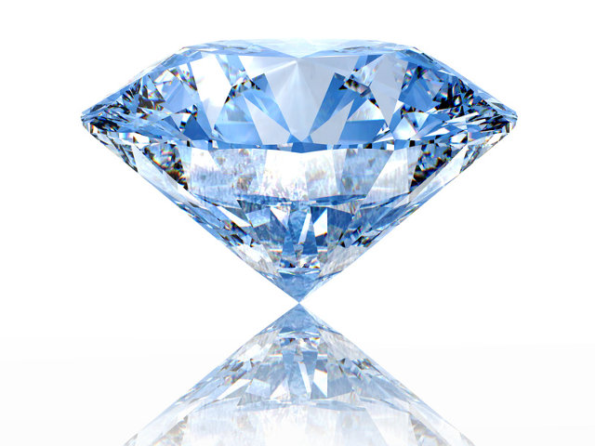
How Diamonds Form
Gavin McRoy

Slide 2
Let's Talk About Diamonds
Misconceptions
Diamond Forming Conditions
Notes:
A Lot of people believe that diamonds are sourced from coal. This could not be farther from the truth. Diamonds have existed longer than there has been living creatures on the planet which is what causes the formation of coal. Rather diamonds are formed from incredible heat and pressure somewhere 90 miles in the earth where temperatures range to about 2000F. It's with these temperatures that diamonds can be formed and remain stably. Diamonds reach the surface through volcanic activity whether it be igneous intrusions or other means. Also as a fun fact diamonds are incredible unstable at normal atmospheric pressure and diamonds exposed to such condition are slowly transforming into graphite

Slide 3
How do they form?
Subduction Zones
Space
Meteor Collisions
In the Mantle
Notes:
Diamonds take billions of years to form under constant exposure of incredible heat and temperature. The romans used to think diamonds where tears cried by the gods

Slide 4
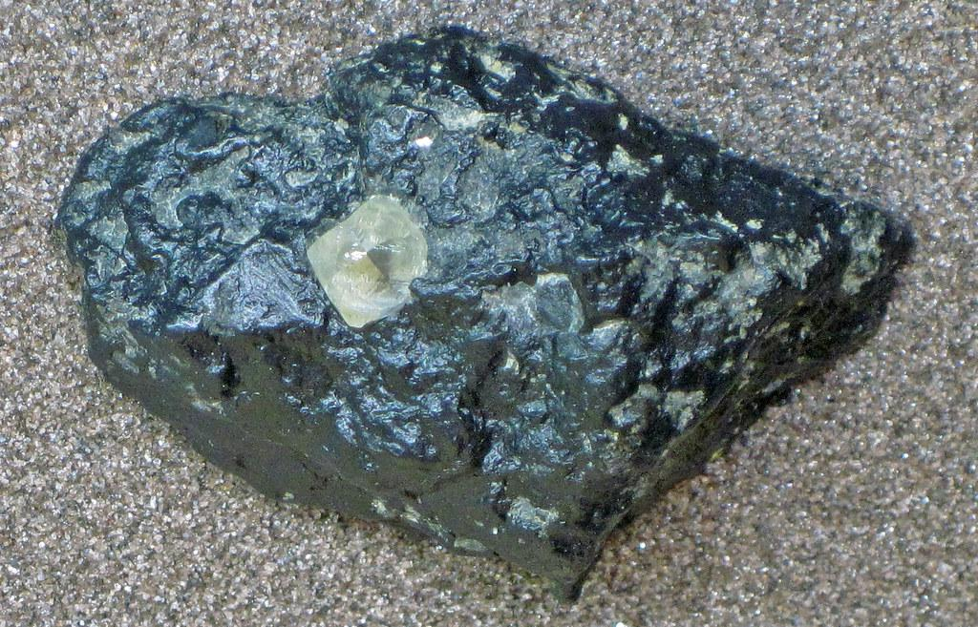
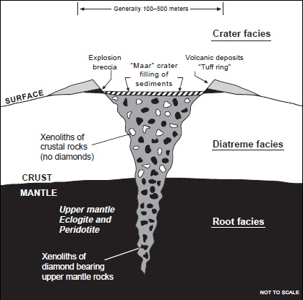
How Diamonds Reach the Surface
Kimberlite Pipes
Notes:
Through a very rare type of igneous intrusion called Kimberlite Pipes that takes thousands of years. Once it reaches the surface it's incredibly violent and often more explosive than some of the biggest recorded eruptions.

Slide 5
How are Diamonds Mined
Pit Mining
Alluvial Mining
Marine Mining
Notes:
Pit mining is pretty boring. Basically miners dig out the surface of a kimberlite deposit and load it with explosives. They detonate a massive deep explosion that breaks all the ore up where it is then hauled out to special processing plants that sort and collect the diamonds. Alluvial mining is a little bit different in that it searches for where the eroded sediments of kimberlite may have been deposited. Over time they can be completely eroded allowing for diamonds to be deposited across in rivers. Marine mining is basically a massive vacuum that sucks up gravel to be processed. The coasts of africa are actually the richest location for diamonds

Slide 6
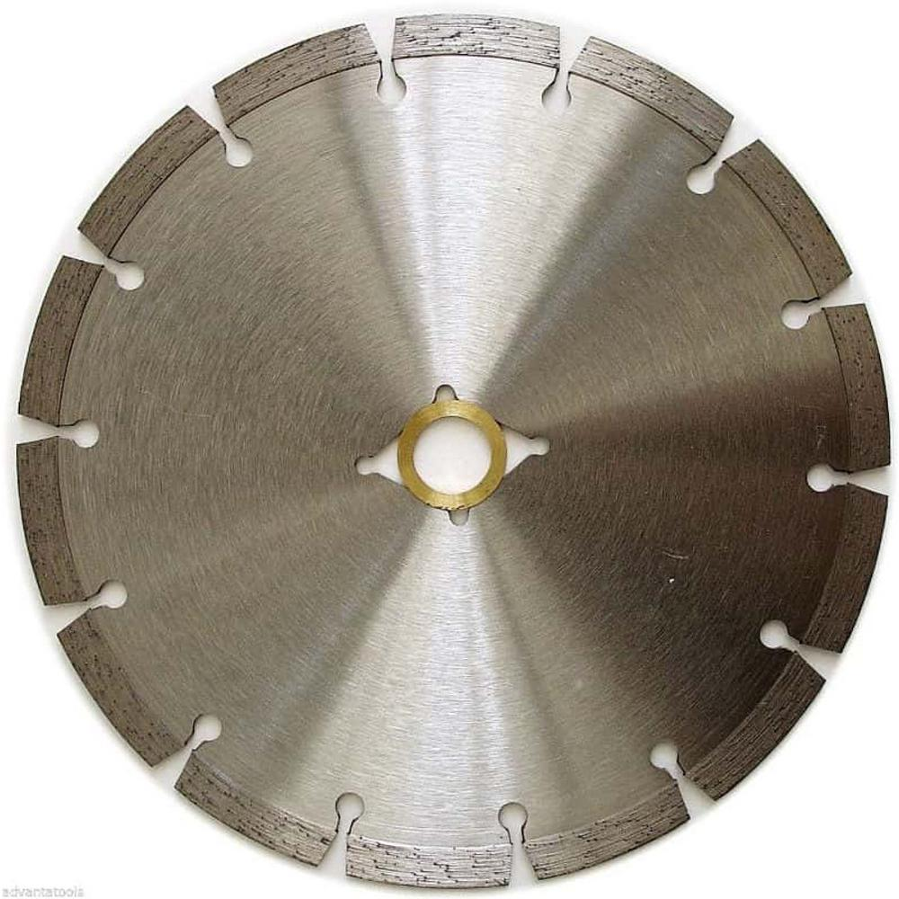

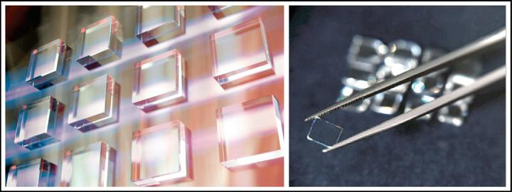
Usage
Saw blades (Any Abrasive Use)
Computer Chips
Record Player Needles
Notes:
Diamonds have many uses that most people wouldn't even be aware of. One of the most common known usages of diamonds is in abrasive applications such as saws and drills. But not many people know that diamonds are actually used in computer chips to increase performance as well as in the tip the needle in a record player. The reason for this is diamonds can vibrate very quickly without undergoing any deformation making it one of the #1 picks for anyone who is a audiophile

Slide 7
Sources
https://geology.com/articles/diamonds-from-coal/
https://www.shimansky.co.za/discover/about-diamonds/mining
https://www.capetowndiamondmuseum.org/blog/2017/05/fascinating-uses-for-diamonds-beyond-jewellery-making/

